Slide 1
Hyperspectral Imaging of Historical Artifacts: The Selden Map of China
David Messinger, Ph.D.
Di Bai, Ph.D. Candidate
Rochester Institute of Technology
David Howell, Bodleian Library, University of Oxford

Slide 2
What is Spectral Imaging?
Over time (passive) imaging systems have improved their spectral (i.e., color) response, range, and sensitivity
  B&W (1 spectral band)
  Color (RGB, 3 spectral bands)
  “Multispectral” (typically a filtered or colored illumination system)
  “Hyperspectral” (use of a diffraction element such as a prism or grating)
Why more bands?
  more spectral information leads to greater material separability

Slide 3
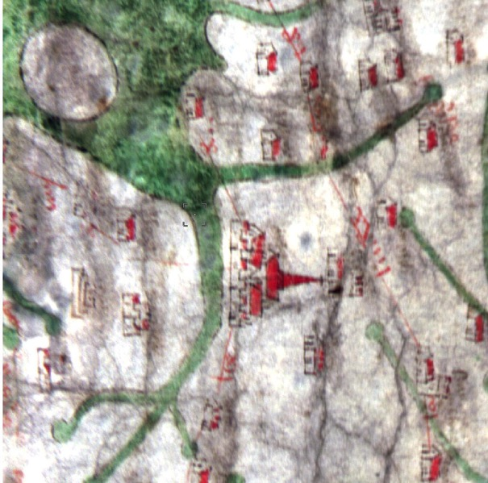
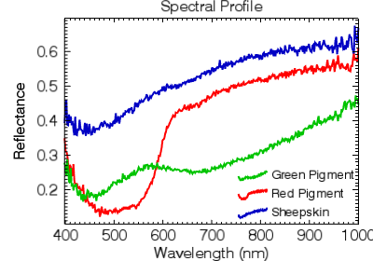
Why Use Hyperspectral Imaging?
Different materials have a different “color” as measured across a wide range of wavelengths

Slide 4
Why Use Hyperspectral Imaging?
Reflectance HSI produces a per pixel spectroscopic signature of the spatial and spectral coverage and response defined by the sensor
Each signature is directly related to the material in that pixel
(Sometimes) allows for identification of subtle material differences
Here, we use HSI for codicological studies, primarily of pigments in two medieval maps

Slide 5
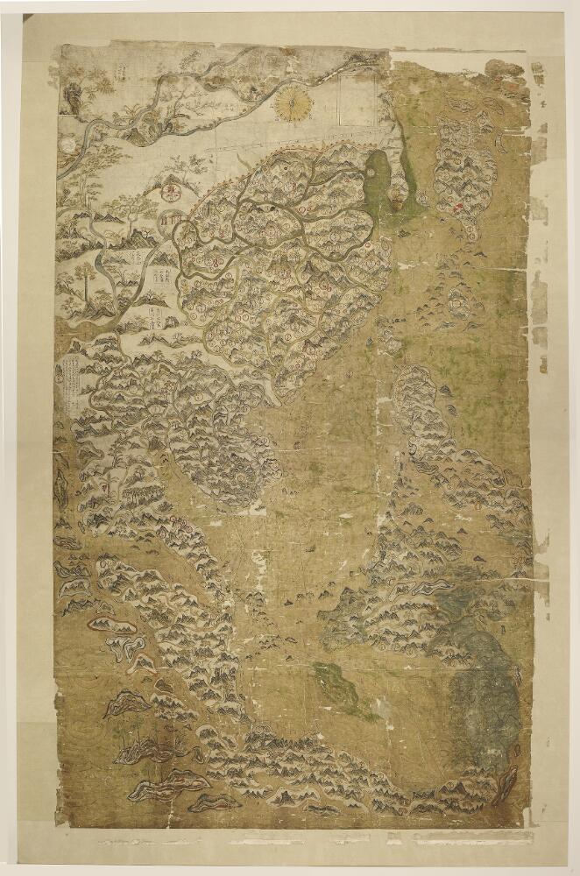
Example Artifact: Selden Map of China
Selden Map: an early 17th century wall map of East Asia.
It was rediscovered in 2008 at the Bodleian Library, Oxford University.
The map was drawn with carbon ink and watercolors on Chinese paper.
There are mountains, rivers, ocean waves, forests, plants and flowers.
Six different colors were used: red, green, blue, yellow, white and black.
Goal: Analyze the variety of green pigments used to delineate water
Korea
Japan
Ming Empire
Indian Sea
Eastern Sea
Vietnam
Sumatra
Banda
Ambon
Java
Notes:
This is the Gough map, it was created in the 14th century, It’s one of the earliest surviving maps of Britain.
It contains the England in the south, Scotland in the north and the Hadrian’s Wall.
The green region stands for the ocean, waterways and the small red items are town signs.

Slide 6

Comparison to Modern Map
Korea
Japan
Ming Empire
Indian Sea
Eastern Sea
Vietnam
Sumatra
Banda
Ambon
Java

Slide 7
The Selden Map: Unique Features
Korea
Japan
Ming Empire
Indian Sea
Eastern Sea
Vietnam
Sumatra
Banda
Ambon
Java
Notes:
This is the Gough map, it was created in the 14th century, It’s one of the earliest surviving maps of Britain.
It contains the England in the south, Scotland in the north and the Hadrian’s Wall.
The green region stands for the ocean, waterways and the small red items are town signs.

Slide 8
The Selden Map: Unique Features
compass
scale
Great Wall
directions to points west
navigational routes
Notes:
This is the Gough map, it was created in the 14th century, It’s one of the earliest surviving maps of Britain.
It contains the England in the south, Scotland in the north and the Hadrian’s Wall.
The green region stands for the ocean, waterways and the small red items are town signs.

Slide 9
The Selden Map: Unique Features
cities
heading information
current information
navigational routes
Notes:
This is the Gough map, it was created in the 14th century, It’s one of the earliest surviving maps of Britain.
It contains the England in the south, Scotland in the north and the Hadrian’s Wall.
The green region stands for the ocean, waterways and the small red items are town signs.

Slide 10
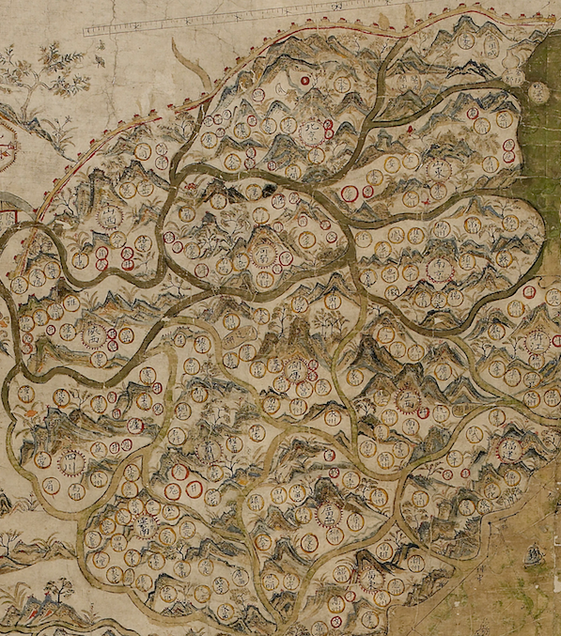
The Selden Map: Overview
Korea
Japan
Ming Empire
Indian Sea
Eastern Sea
Vietnam
Sumatra
Banda
Ambon
Java
Notes:
This is the Gough map, it was created in the 14th century, It’s one of the earliest surviving maps of Britain.
It contains the England in the south, Scotland in the north and the Hadrian’s Wall.
The green region stands for the ocean, waterways and the small red items are town signs.

Slide 11
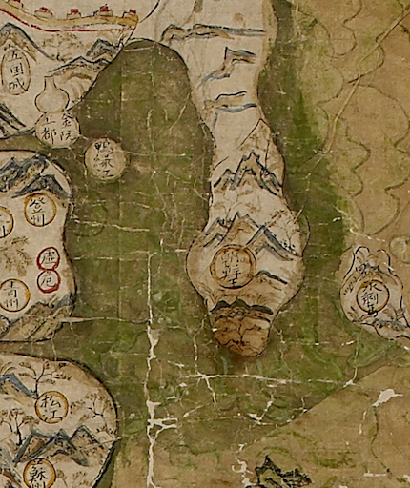
The Selden Map: Overview
Korea
Japan
Ming Empire
Indian Sea
Eastern Sea
Vietnam
Sumatra
Banda
Ambon
Java
Notes:
This is the Gough map, it was created in the 14th century, It’s one of the earliest surviving maps of Britain.
It contains the England in the south, Scotland in the north and the Hadrian’s Wall.
The green region stands for the ocean, waterways and the small red items are town signs.

Slide 12
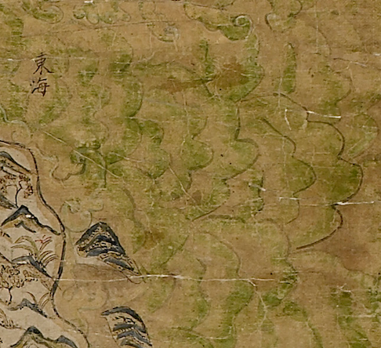
The Selden Map: Overview
Korea
Japan
Ming Empire
Indian Sea
Eastern Sea
Vietnam
Sumatra
Banda
Ambon
Java
Notes:
This is the Gough map, it was created in the 14th century, It’s one of the earliest surviving maps of Britain.
It contains the England in the south, Scotland in the north and the Hadrian’s Wall.
The green region stands for the ocean, waterways and the small red items are town signs.

Slide 13
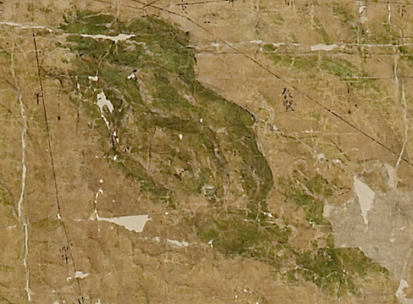
The Selden Map: Overview
Korea
Japan
Ming Empire
Indian Sea
Eastern Sea
Vietnam
Sumatra
Banda
Ambon
Java
Notes:
This is the Gough map, it was created in the 14th century, It’s one of the earliest surviving maps of Britain.
It contains the England in the south, Scotland in the north and the Hadrian’s Wall.
The green region stands for the ocean, waterways and the small red items are town signs.

Slide 14
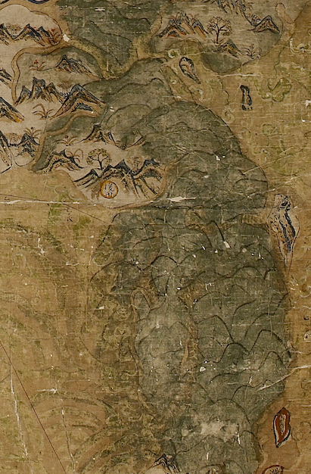
The Selden Map: Overview
Korea
Japan
Ming Empire
Indian Sea
Eastern Sea
Vietnam
Sumatra
Banda
Ambon
Java
Notes:
This is the Gough map, it was created in the 14th century, It’s one of the earliest surviving maps of Britain.
It contains the England in the south, Scotland in the north and the Hadrian’s Wall.
The green region stands for the ocean, waterways and the small red items are town signs.

Slide 15
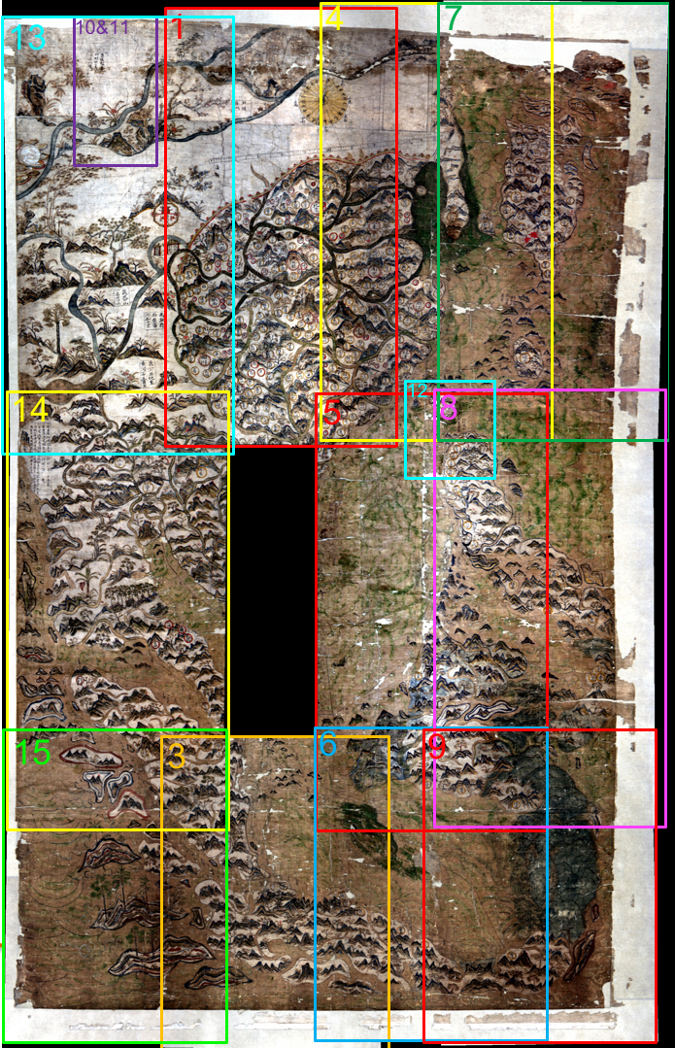
Image Collection in Overlapping Chips
100cm
160cm
Notes:
To ensure full coverage of the map with sufficient spatial resolution, the image collection was done in several spatially overlapping chips. We label them as shown

Slide 16
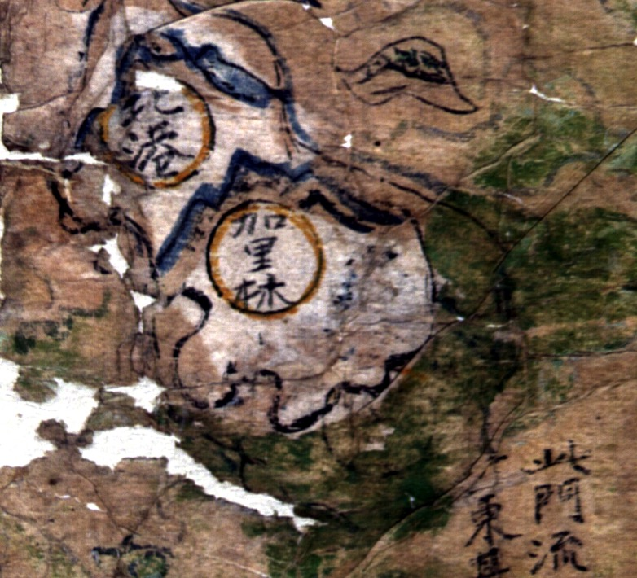
Early Analysis - Taiwan
CIS HS Interns:
Paige Phillips
Emily Polo Rankin
Chip of Taiwan
According to map scholar Bob Batchelor:
“The green corrections on the map (... middle right Taiwan; ... ). In general, is there anything more to see in these? The first run of the data gave a pretty clear outline of the Sulawesi correction and the rest seem to be visible through the regular scan. In general, it would be good to have best images ... that show the contrasts.”

Slide 17

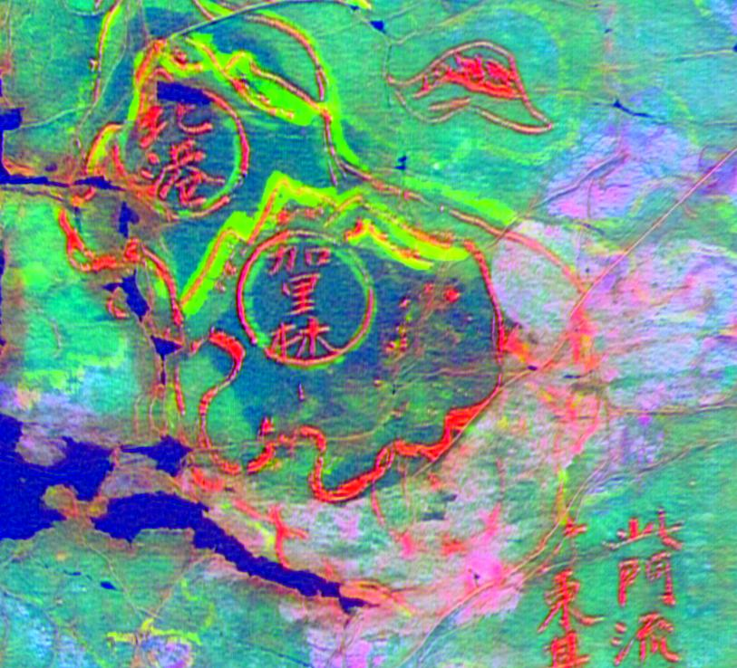
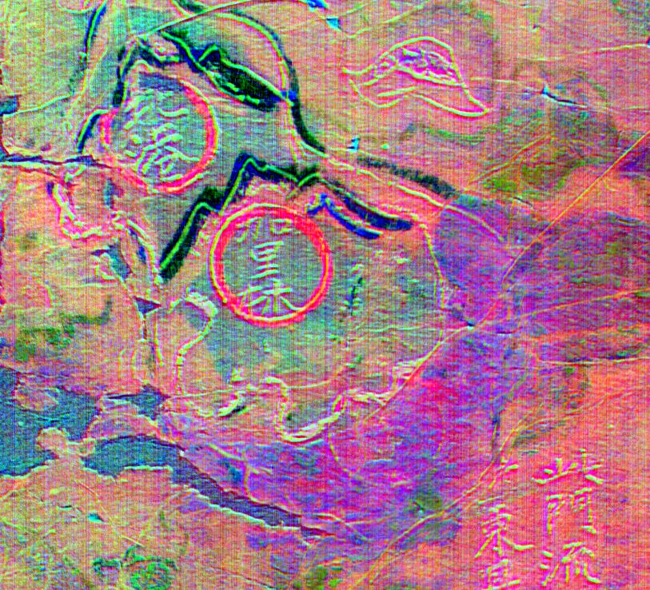
Taiwan Corrections
RGB
PCA False Color

Slide 18
Primary Application: Within Color Pigment Differentiation
A typical HSI application is image classification / segmentation
  Goal: label each pixel as belonging to one of n classes, where n is generally known or assumed
  Classes are generally well separated
The artifacts to be explored here look relatively homogeneous, but are known to have been modified over time
Goal: identify spatial patterns within the dominant pigments that may highlight patterns of creation or modification
Challenge: within-material differentiation is difficult…... And we have no ground truth.....

Slide 19
Pigment Analysis Methodology
Method
  Extract pixels of common color of interest (i.e., red or green)
  Per chip, identify number of types of red (or green) spectra
  Combine unique spectra across the entire map
  Estimate number of unique red (or green) spectra globally
  Label each pixel by spectral unmixing and classification in abundance space
  Map results back into image space to identify spatial patterns
  “Hyperspectral Analysis of Cultural Heritage Artifacts: Pigment Material Diversity in the Gough Map of Britain”, D. Bai, D.W. Messinger, & D. Howell, Optical Engineering, 56(8), 2017
  “A Hyperspectral Image Spectral Unmixing and Classification Approach to Pigment Mapping in Historical Artifacts”, D. Bai, D.W. Messinger, & D. Howell, submitted to JAIC, April 2018

Slide 20
Pigment Analysis Methodology
How do we identify number of distinct materials in sample?
  In HSI analysis the number of materials is generally assumed to be related to the “dimensionality” of the data.
    This is generally a bad assumption…...
    But mathematically it’s something we can do, so.....
  We use an approach called the Gram Matrix which selects exemplar spectra (endmembers) and uses a convex hull model to identify which collection of vectors are linearly independent
  Exemplar spectra collected with technique called MaxD
How do we label the pixels?
  We perform spectral (linear) unmixing to represent each pixel as a set of abundances
  We perform classification in the abundance space

Slide 21
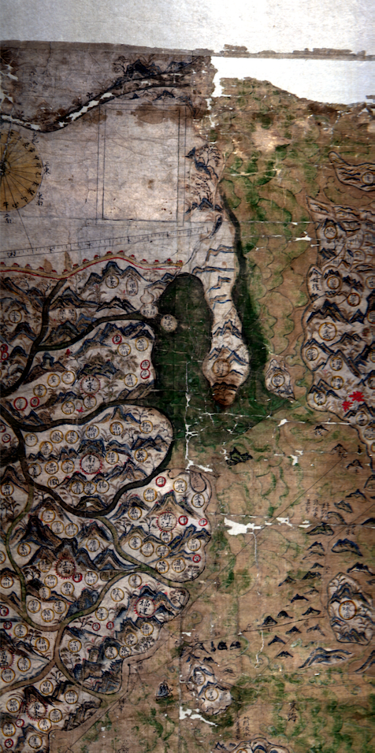
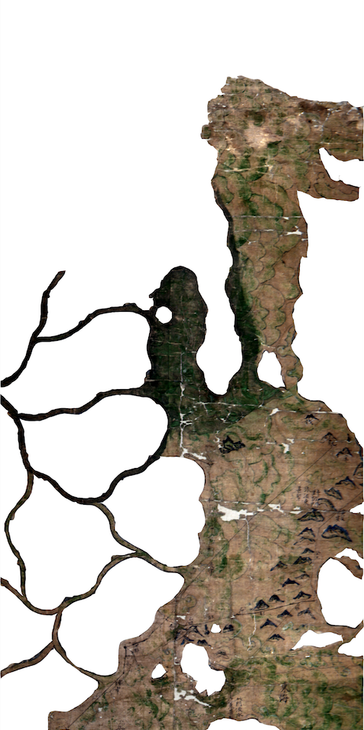
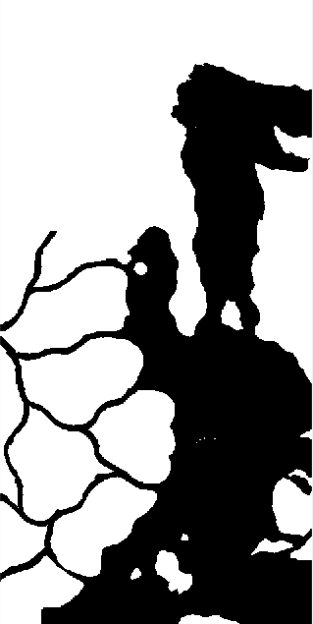
Create Masks and Extract Green Pigments
Original Chip 4
Mask of Chip 4
Binary Image

Slide 22
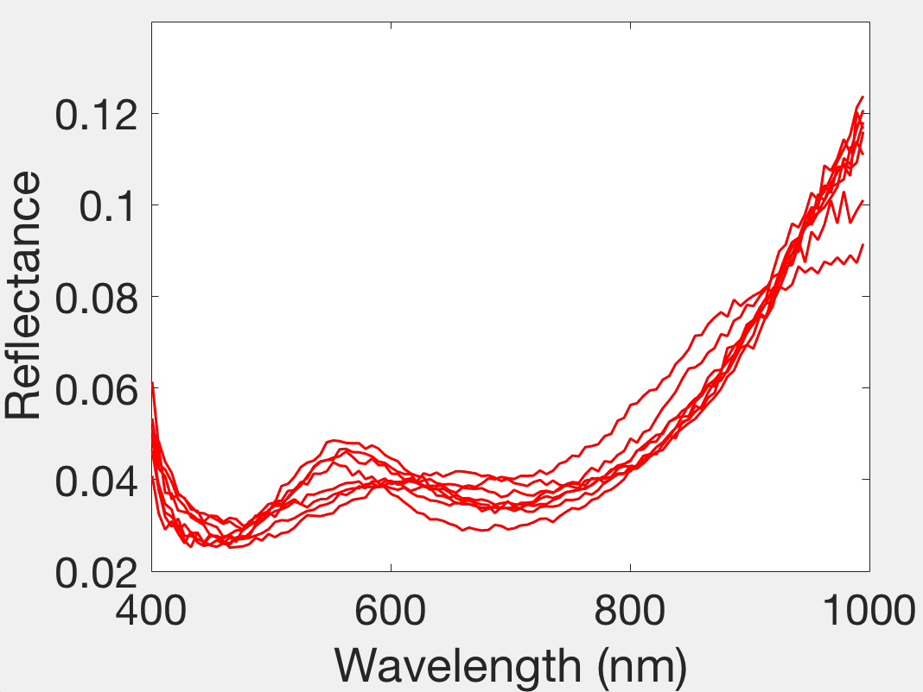
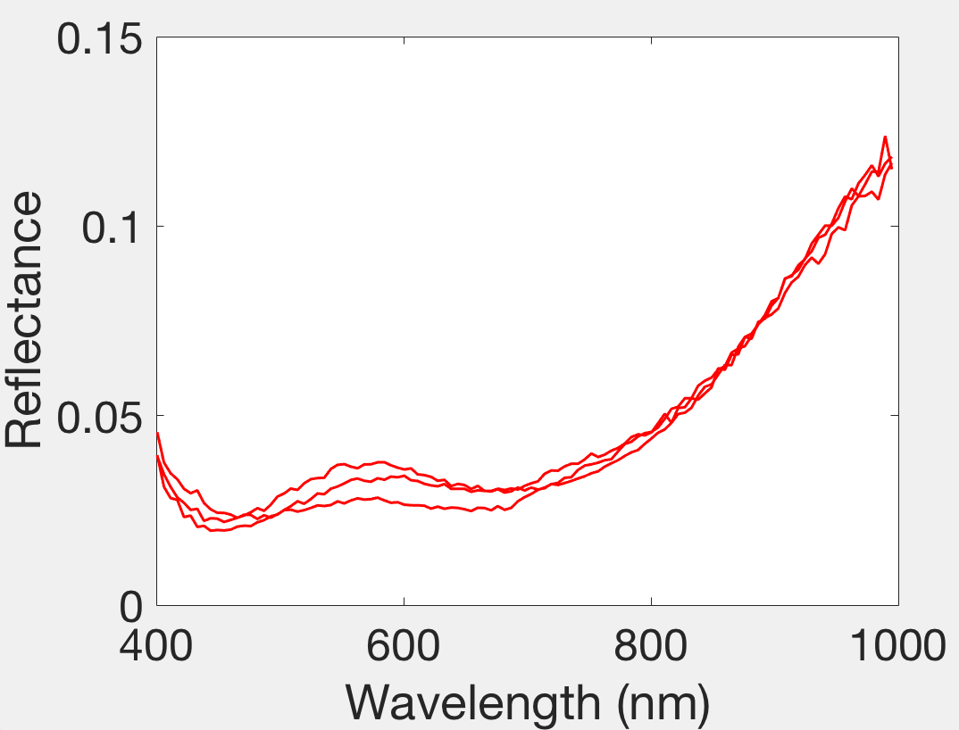
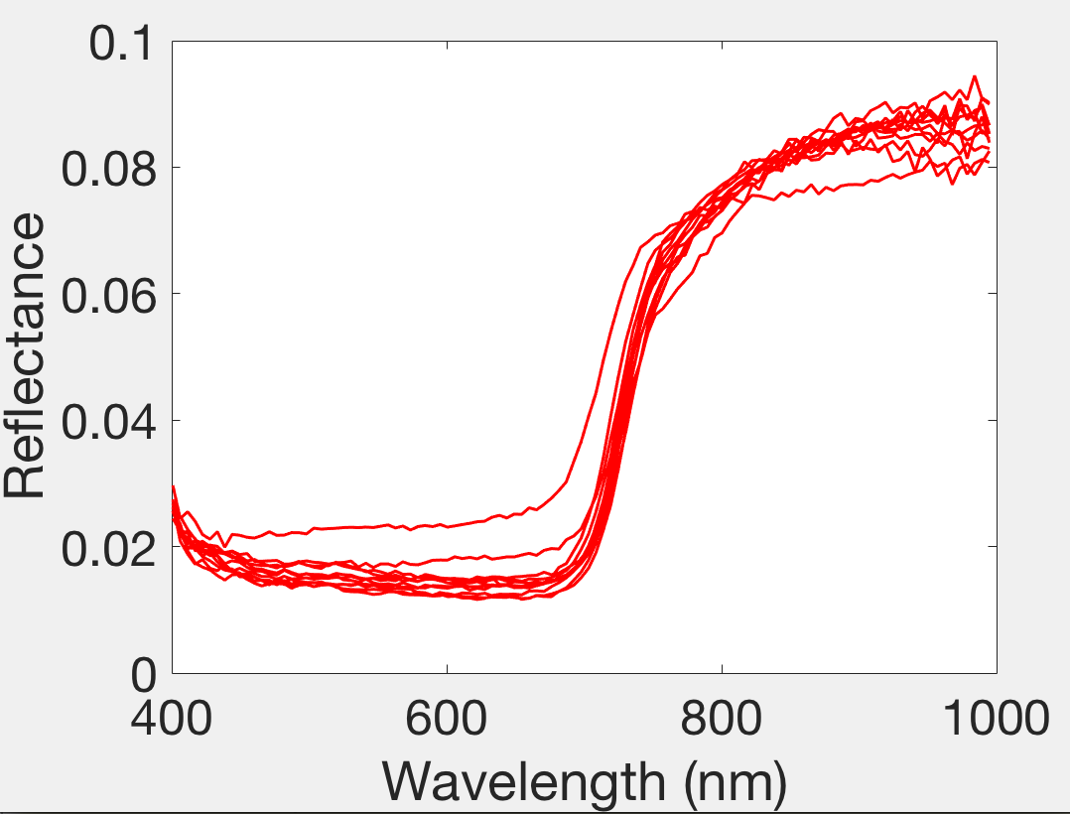
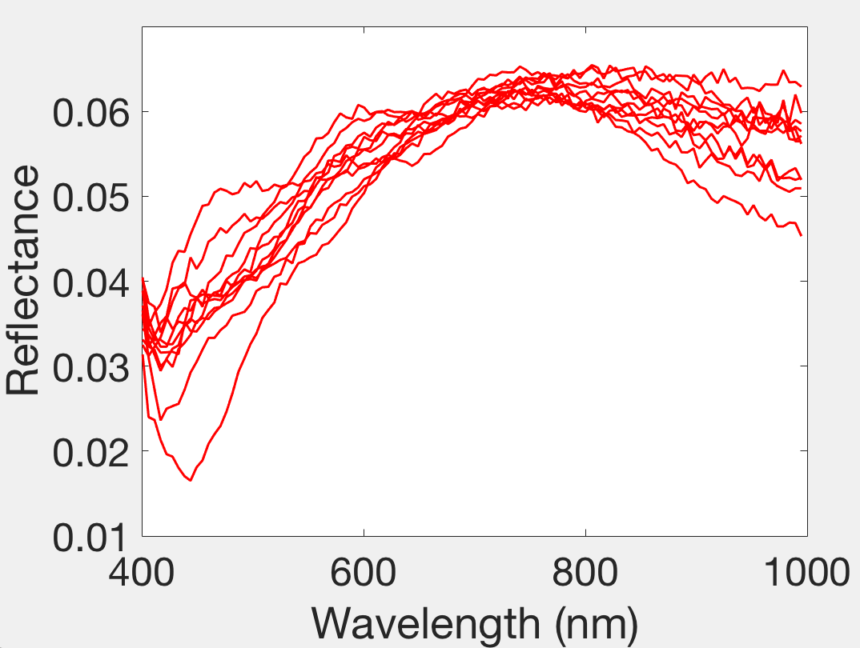
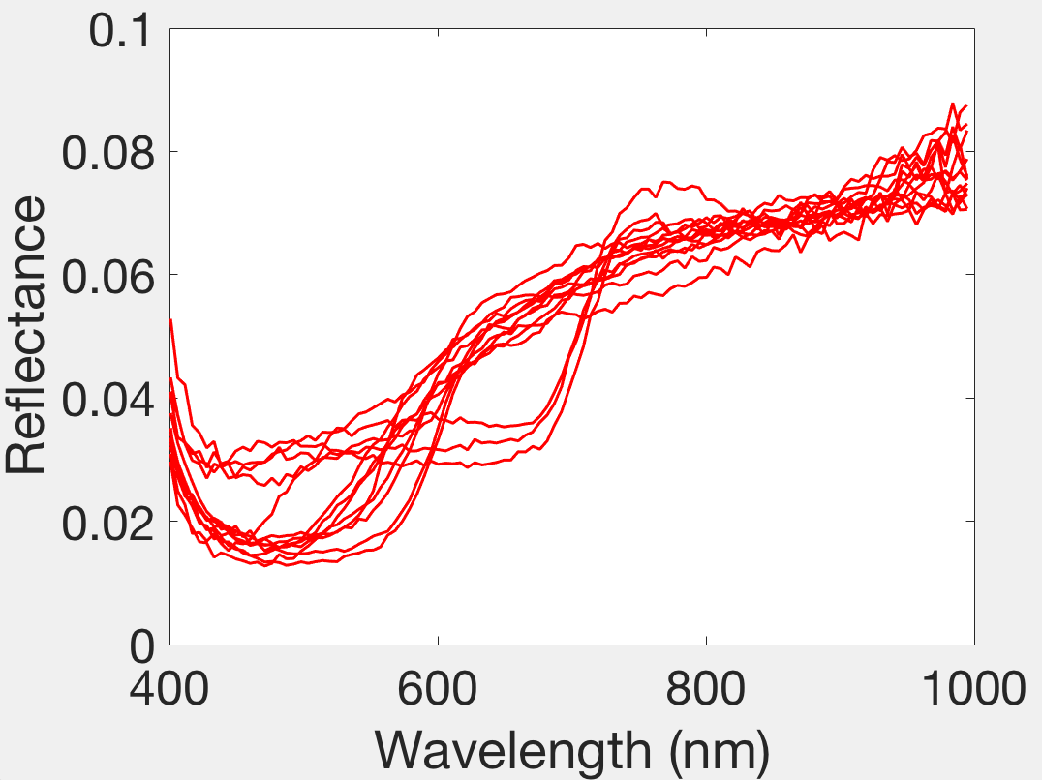
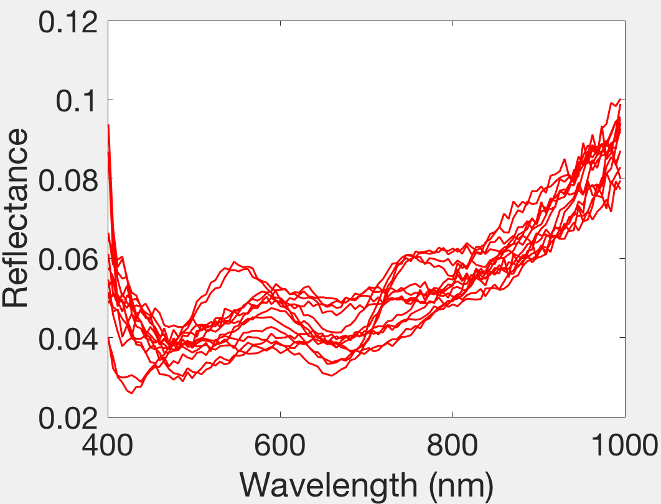
Classify Global Endmembers: K-means
Notes:
Since there are 6 distinct global green pigments, we simply run k-means to the 18 output spectra, and classify them into 6 classes

Slide 23
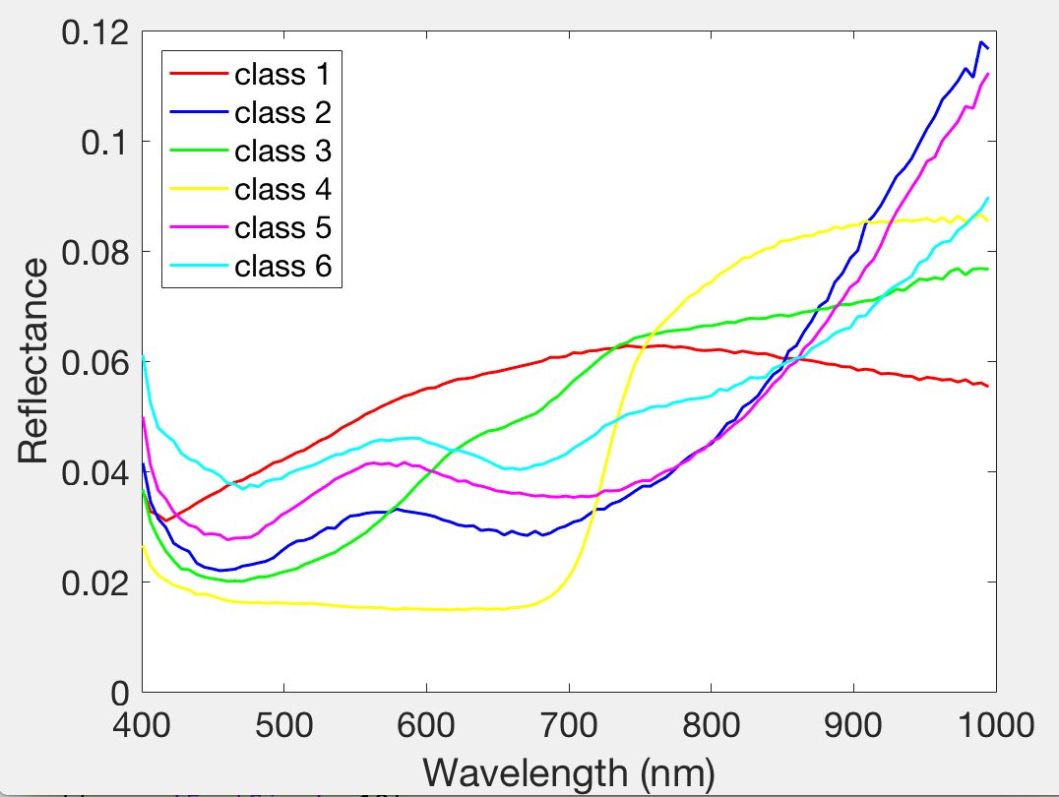
Results: Green Pigments
Results indicate 6 classes of green pigments used across the map with unique spectral signatures
Notes:
Then do an average to each cluster. Now we have six global endmembers of the green pigments.

Slide 24
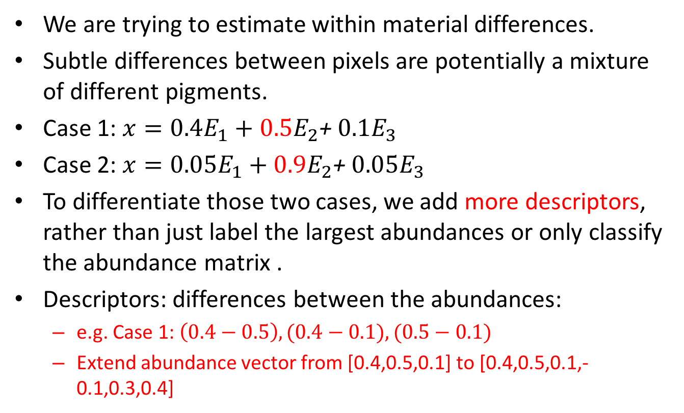
Add Descriptors to the Abundance Matrix
We are trying to estimate within material differences.
Subtle differences between pixels are potentially a mixture of different pigments.
Case 1: $x=0.4E_{1}+0.5E_{2}$+ $0.1E_{3}$
Case 2: $x=0.05E_{1}+0.9E_{2}$+ $0.05E_{3}$
To differentiate those two cases, we add more descriptors, rather than just label the largest abundances or only classify the abundance matrix .
Descriptors: differences between the abundances:
  e.g. Case 1: $\left(0.4−0.5\right),(0.4−0.1),(0.5−0.1)$
  Extend abundance vector from [0.4,0.5,0.1] to [0.4,0.5,0.1,-0.1,0.3,0.4]

Slide 25
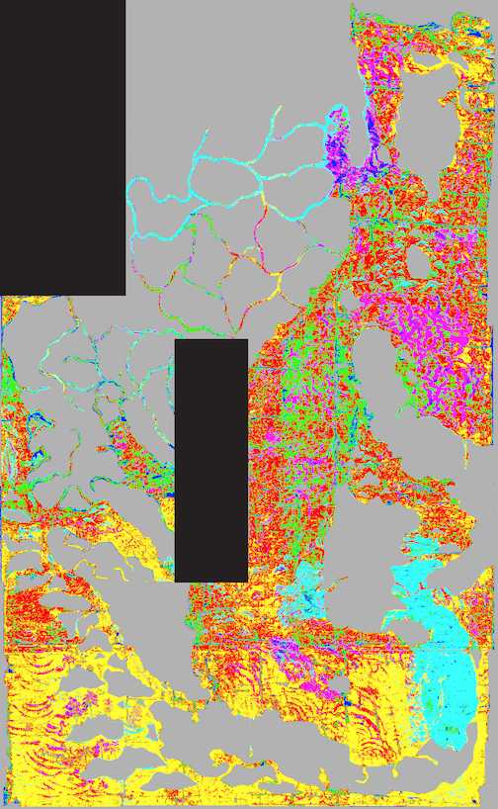
Results: Green Pigment Spatial Patterns
Original Map
Class Labels
No green pigments
No data
Notes:
Then stitch images together. We have this final classification.
It shows the ocean area are mainly in red, coastal and waterways are in blue, and some faded area are in green color

Slide 26
Results: Interpretation
Original Map
Class Labels
A clear separation between the north and south of the rivers inside the Ming Empire.
The green pigment of the rivers in the north side is the same as the pigments used in Ambon and west of the Banda.
Notes:
Then stitch images together. We have this final classification.
It shows the ocean area are mainly in red, coastal and waterways are in blue, and some faded area are in green color

Slide 27
Results: Interpretation
Original Map
Class Labels
The boundary pigment of Korea is the same as the rivers in the north of Ming Empire, but it is different from those in sea around Korea.
The pigment in sea around Korea is similar to the green pigment in the green land between Java and Banda.
Notes:
Then stitch images together. We have this final classification.
It shows the ocean area are mainly in red, coastal and waterways are in blue, and some faded area are in green color

Slide 28
Results: Interpretation
Original Map
NNLS + abundances
The green waves of the Eastern Sea are easily separated even in low contrast in RGB.
Also notice that there is a folding line in the south of this map.
Notes:
Then stitch images together. We have this final classification.
It shows the ocean area are mainly in red, coastal and waterways are in blue, and some faded area are in green color

Slide 29
Summary
Hyperspectral Imagery is of sufficient spectral and spatial resolution to analyze pigment differences across large artifacts
  Here: Selden Map (early 17th century)
Different algorithmic challenge: assessing within material differences to go beyond visual color comparison
Can (hopefully) be a useful tool for codicological studies on a number of potentially large artifacts
Other ongoing work:
  Panchromatic sharpening of HSI
  Advanced algorithmic approaches for pigment and faded text analysis

Slide 30
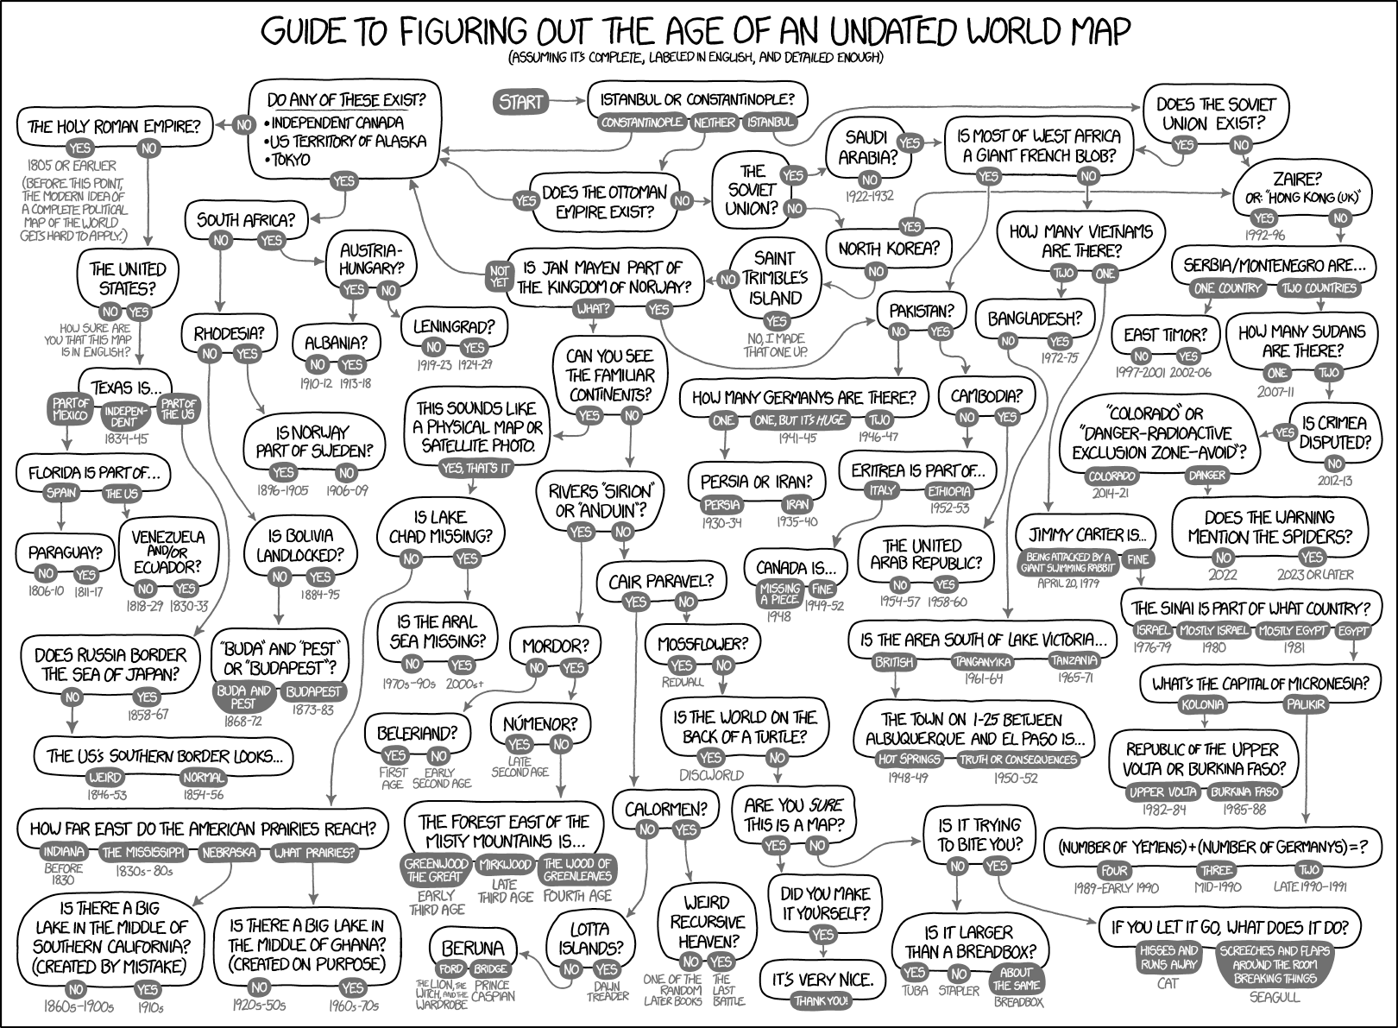
Questions?
David Messinger
messinger@cis.rit.edu
https://xkcd.com/1688/

Slide 31
Validate the Classification Results
Due to the absence of ground truth data, we use four different ways to classify the HSI of the Selden Map.
To validate the results, we use Spectral Angle Spatial Patterns:
  Compute the mean spectrum within each class.
  Take the mean spectrum as the representative of this class.
  Compute spectral angle between each point and the mean spectrum.
  Replace each pixel’s value by this spectral angle.
  Map the results back to the image.

