Slide 1
What Is Spectral Imaging?
An Introduction
David Messinger, Ph.D.
Rochester Institute of Technology

Slide 2
What is Spectral Imaging?
Over time (passive) imaging systems have improved their spectral (i.e., color) response, range, and sensitivity
  B&W (1 spectral band)
  Color (RGB, 3 spectral bands)
  “Multispectral” (typically a filtered or colored illumination system)
  “Hyperspectral” (use of a diffraction element such as a prism or grating)
Why more bands?
  more spectral information leads to greater material separability

Slide 3
Basic Outline of Talk
Definitions: light, wavelength, and color
Overview of imaging systems
  What the camera sees
  How to collect color imagery
  Difference between multi- & hyperspectral
  Calibration, registration
Basic image processing concept
  Spatial processing
  Spectral processing
Questions

Slide 4
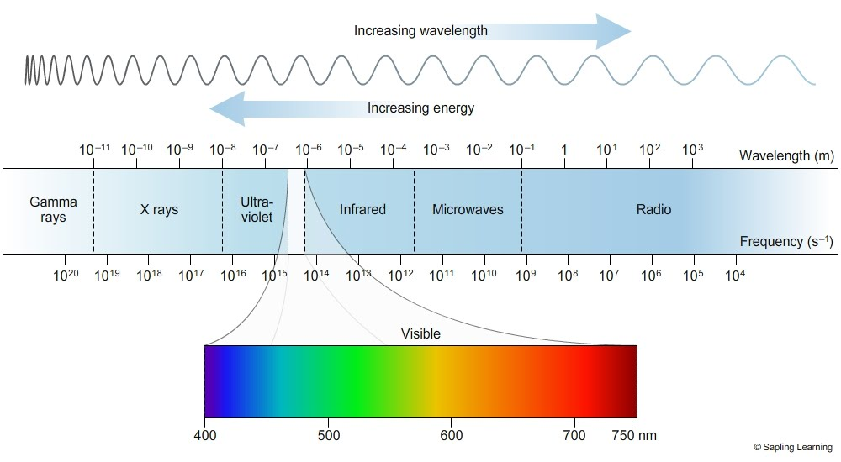
Definitions
Wavelength: related to the energy of light and color; typically written as λ

Slide 5
Definitions
Color: optical property of materials; how it selectively reflects light
Reflectance: efficiency with which an object reflects light as a function of wavelength
Fluorescence: material property by which light is emitted at a different wavelength that it is illuminated with
Spectral band / channel: a specific color in an imaging system
Resolution: the projected area of each pixel on the detector onto the object
Spectral response: how sensitive the detector is to each wavelength of light

Slide 6
Imaging System: What the Camera Sees
light source
camera
Reflectance vs.
Transmission vs.
Fluorescence
Table to hold object

Slide 7
Imaging System: Your Cell Phone
light source
camera
Placed in front of camera detector
notional “Bayer” pattern for RGB digital camera
Table to hold object

Slide 8
Imaging System: Filter Wheel
light source
camera
Placed in front of camera and rotates
Table to hold object

Slide 9
Imaging System: Colored Illuminant
camera
color of light source is modified
Must be done in the dark!
Table to hold object

Slide 10
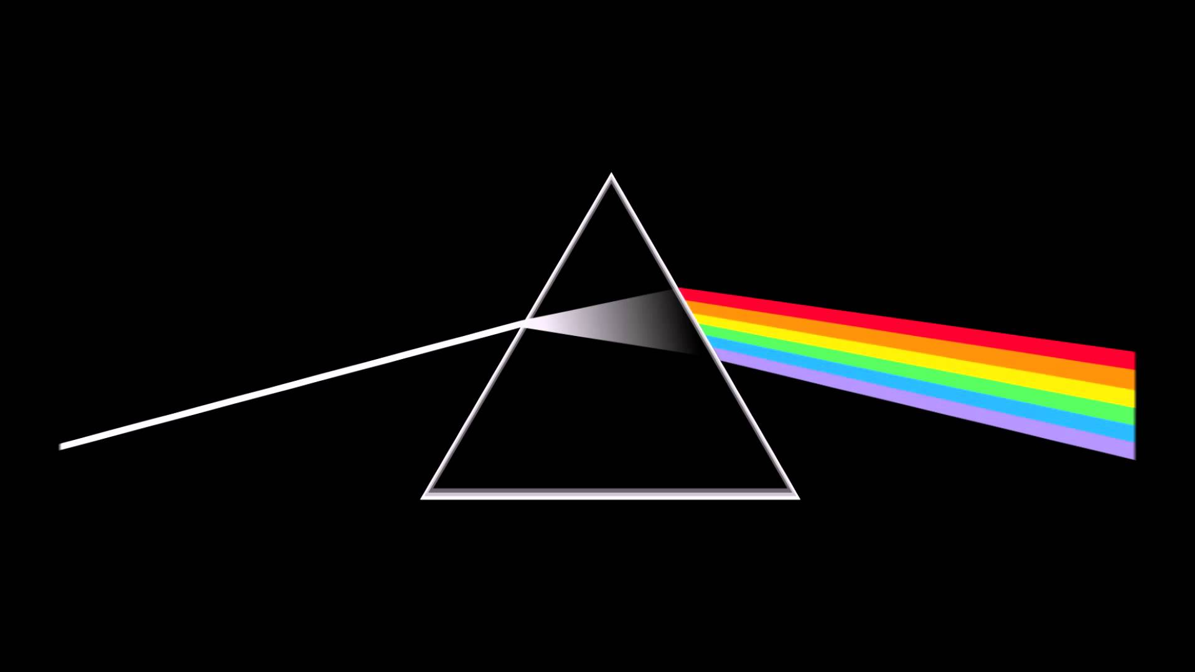
Multi- vs. Hyper- Spectral
My definitions
MSI
  Spectral imaging system that uses filters or colored illumination
  Generally has 10’s of spectral bands without continuous spectral coverage
  Generally has higher spatial resolution
HSI
  Uses a dispersion element to project
  “rainbow” onto detector
  Either the object or the camera has to
  move
  Produces continuous spectrum per pixel
  Generally lower spatial resolution

Slide 11
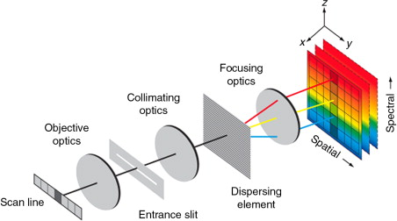
Basic Hyperspectral Imaging System
For spectroscopy, we need to spread the light out using a diffraction grating or a prism
Image is collected one line at a time, but full spectral information is collected for each line on 2D array
Second spatial dimension collected by platform or object motion
2D detector array
1D collection aperture

Slide 12
Calibration
Camera records digital counts – raw data
Can be converted to radiance (physical units) with calibration coefficients
Can be converted to reflectance with known target in scene
Different from color balancing

Slide 13
Image Registration
Two images of same object at different wavelengths but slightly offset
Images simply overlaid in pixel space
Images registered by content

Slide 14
Spatial Image Processing
Uses information contained in the spatial domain
  Pixels are next to each other
Typically (but not always) done on a single band image
Examples
  Sharpening and filtering, attempting to remove blur
  Edge detection

Slide 15
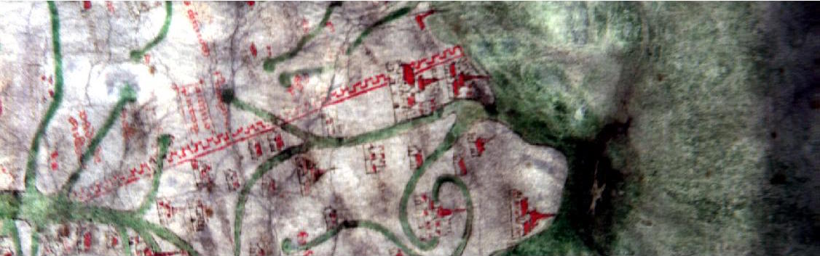
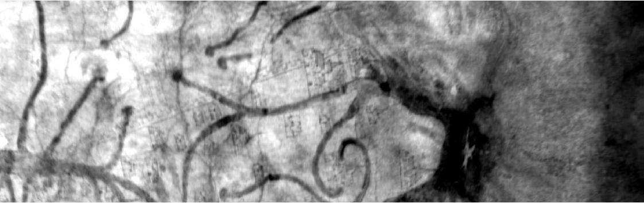
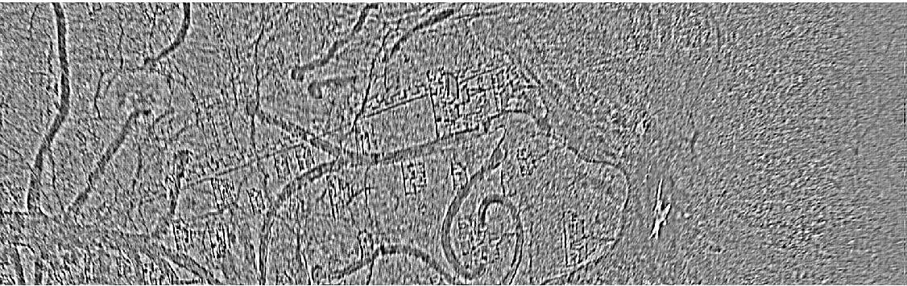
Spatial Image Processing
RGB from hyperspectral
PC band 1
High Pass Filtered

Slide 16
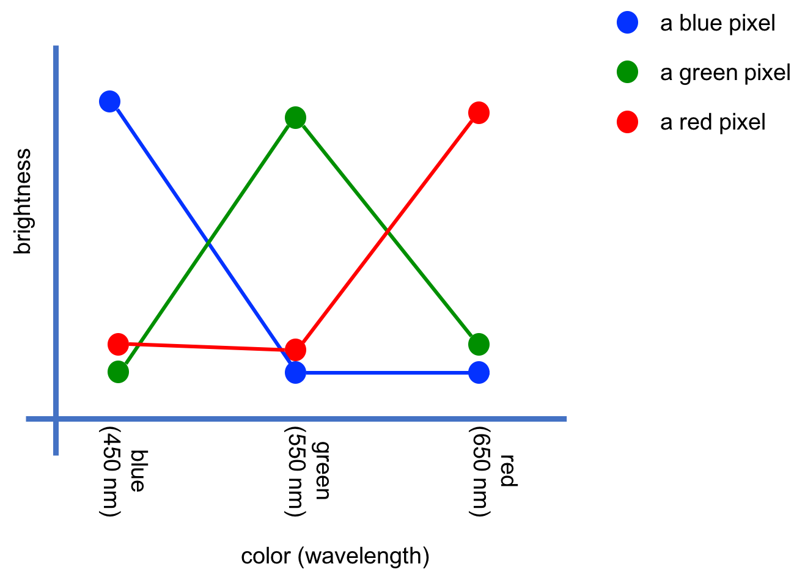
Spectral Imaging Processing: Signatures
The actual measurement in each band
How “bright” is this object in this band relative to the other bands?
Useful for identifying bands of high contrast and for assessing spectral similarity

Slide 17
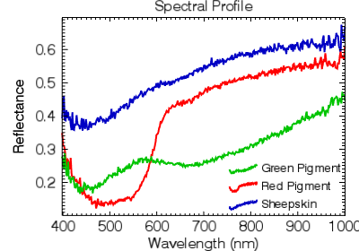
Hyperspectral Pixel Signatures
Spectral measurement (reflectance) as a function of wavelength for three different materials

Slide 18
Spectral Signatures in the Color Space
We think of pixels as points in a space where the axes are the various colors
Specific colors fall on the axes, mixtures fall in the space in between
Provides a mathematical description of the data that is useful
blue
red
green

Slide 19
Principal Components Analysis (PCA
blue
Consider this collection of pixels in two colors
They represent two different materials, but their color differences are subtle
Looking at them in either red or blue alone makes it difficult to distinguish
As seen from the blue axis: difficult to separate
red
As seen from the red axis: difficult to separate

Slide 20
Principal Components Analysis (PCA)
blue
new PCA axis 2
PCA provides a way to represent them with new axes
New axes are derived to maximize separation in first PCA dimension (band)
Now materials are easy to separate
Points are now easy to separate in PCA band 1
new PCA axis 1
red

Slide 21
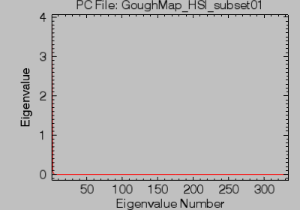
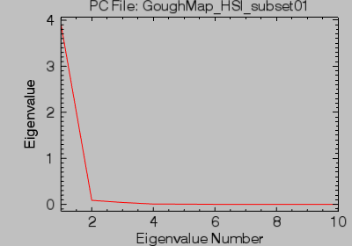
Principal Components Analysis (PCA)
What’s that weird plot ENVI gives me when I run PCA but before I see my result?
The “eigenvalues”: numbers that describe the amount of variability in each new band
When they go to zero there isn’t any more information contained
Related to the material diversity in the scene

Slide 22
Spectral Similarity Measures
We measure how similar pixels are to each other based on their spectral similarity
Pixels of similar material will have similar spectral signatures
  And will appear of similar color in original image and in transformed images such as PCA
Spectral angle is one measure, but there are others
  In the case of spectral angle, smaller values indicate more similar

Slide 23
Spectral Similarity Measures
blue
blue
pixels treated as vectors in color space
red
red
green
green
Angle between two vectors is a measure of color similarity

Slide 24
Other tasks
Target detection
  “known signature detection”
  If I have an exemplar of what I’m looking for, assess how likely every other pixel is to be the same material
Anomaly detection
  Find pixels that are anomalous, or somehow different
Classification
  Label each pixel as belonging to one of n classes
  Can be done automatically or through training data

Slide 25
Questions?
David Messinger
messinger@cis.rit.edu
https://xkcd.com/1688/

